Slide 1
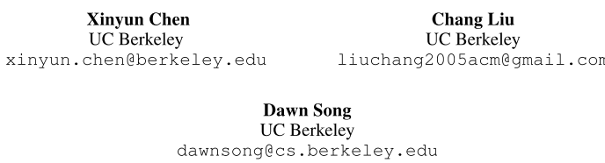
Tree-to-tree Neural Networks for Program Translation
NeurIPS-2018
刘芳
2018-12-19

Slide 2
Introduction

Slide 3
Introduction
There is a tremendous need to enable program translation between different programming languages.
Existing program translation methods:
Rule-based
Inefficient
Error-prone
Neural machine translation methods (sequence-to-sequence-based models)
programming languages have rigorous grammars and are not tolerant to typos and grammatical mistakes.
It is very hard for an RNN-based sequence generator to generate syntactically correct programs when the lengths grow large.
Notes:
introduces a burden when programmers want to combine programs written in different languages together.

Slide 4
Introduction
Main issue of an RNN that makes it hard to produce syntactically correct programs is that it entangles two sub-tasks together:
Learning the grammar
Aligning the sequence with the grammar
When these two tasks can be handled separately, the performance can typically boost.
The structural information of both source and target parse trees can be leveraged to enable such a separation.
A tree-to-tree neural networks to combine both a tree encoder and a tree decoder.
when the decoder expands a non-terminal, it locates the corresponding sub-tree in the source tree using an attention mechanism, and uses the information of the sub-tree to guide the non-terminal expansion.

Slide 5
Problem Definition

Slide 6
Problem Definition
Translating a program in one language into another.
Each input program unambiguously corresponds to a unique parse tree. We can consider the problem as translating a source tree into a target tree.
Definition:
Given two programming languages Ls and Lt, each being a set of instances (pk, Tk), where pk is a program, and Tk is its corresponding parse tree.
We assume that there exists a translation oracle π, which maps instances in Ls to instances in Lt.
Given a dataset of instance pairs (is, it) such that is ∈ Ls, it ∈ Lt and π(is) = it, our problem is to learn a function F that maps each is ∈ Ls into it = π(is)

Slide 7
Tree-to-tree Neural Network

Slide 8
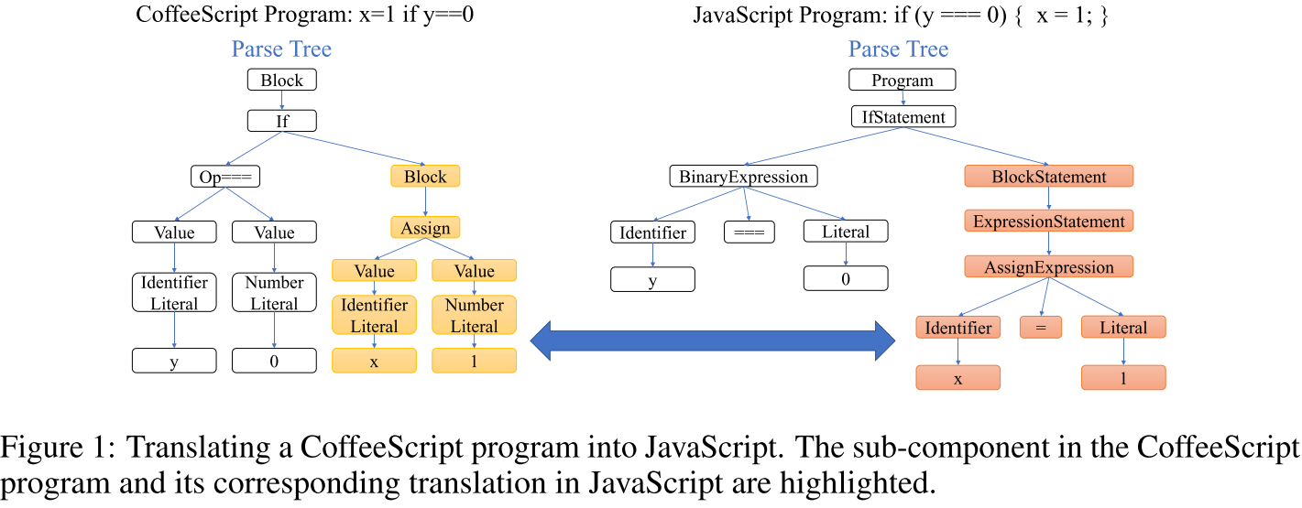
Tree-to-tree Neural Network
Translation process can be modular.
It may be hard for a sequence-to-sequence model to capture the correspondence based on only token sequences without structural information.
Notes:
This correspondence is independent of other parts of the program. Consider when the program grows longer and this statement may repetitively occur multiple times

Slide 9
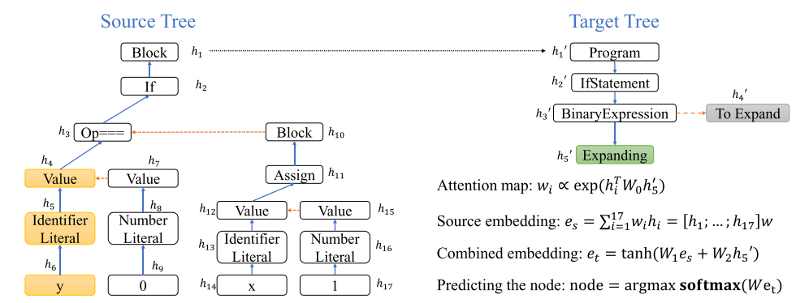
Tree-to-tree Neural Network
A natural solution
Design the tree-to-tree neural network, which follows an encoder-decoder framework to encode the source tree into an embedding, and decode the embedding into the target tree.
To capture the intuition of the modular translation process, the decoder employs an attention mechanism to locate the corresponding source sub-tree when expanding the non-terminal.

Slide 10

Tree-to-tree Neural Network
Converting a tree into a binary one
Encoder and decoder for binary trees can be more effective.
Employ the Left-Child Right-Sibling representation
Binary tree encoder
Employs a Tree-LSTM to compute embeddings for both the entire source tree and each of its sub-tree
the LSTM state (h, c) of N is computed as

Slide 11


Tree-to-tree Neural Network
Binary tree decoder
The decoder generates the target tree starting from a single root node.
The decoder first copies the LSTM state (h, c) of the root of the source tree, and attaches it to the root node of the target tree.
Then the decoder maintains a queue of all nodes to be expanded, and recursively expands each of them.
First, the decoder will predict the value of expanding node.
et is computed using the attention mechanism
tt = <EOS>, then the decoder finishes expanding this node.
Otherwise, the decoder generates one new node as the left child and another new node as the right child of the expanding one
Notes:
et：embedding of the expanding node N
the generation of the left child and right child use two different sets of parameters for LSTML and LSTMR respectively.
we combine the terminal and non-terminal sets into a single vocabulary Vt for the decoder
These new children are pushed into the queue of all nodes to be expanded. When the queue is empty, the target tree generation process terminates.

Slide 12



Tree-to-tree Neural Network
Attention mechanism
To make better use of the information of the source tree, our tree-to-tree model employs an attention mechanism to locate the source sub-tree corresponding to the sub-tree rooted at the expanding node.
This embedding can then be combined with h, the hidden state of the expanding node, to compute et as follows:

Slide 13


Tree-to-tree Neural Network
Parent attention feeding
Attention vectors et are computed independently to each other, since once et is used for predicting the node value tt, et is no longer used for further predictions.
Intuitively, the attention decisions for the prediction of each node should be related to each other.
For example, for a non-terminal node Nt in the target tree, suppose that it is related to Ns in the source tree, then it is very likely that the attention weights of its children should focus on the descendants of Ns
Therefore, when predicting the children of a node, the model should leverage the attention information of its parent as well.
Notes:
the attention vector of the expanding node is taken into account when predicting the attention vectors of its children

Slide 14
Evaluation

Slide 15
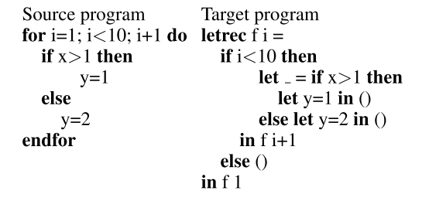
Evaluation
Tasks
Translation between CoffeeScript and JavaScript.
Utilize the CoffeeScript compiler to generate the corresponding ground truth JavaScript programs
Translation of real-world projects from Java to C#, which has been used as a benchmark.
Employ the same approach as in [1] to crawl several open-source projects, which have both a Java and a C# implementation
A synthetic translation task from an imperative language to a functional language.
[1] A. T. Nguyen, T. T. Nguyen, and T. N. Nguyen. Divide-and-conquer approach for multi-phase statistical migration for source code (ASE-2015)

Slide 16
Evaluation
Metrics
Program accuracy
the percentage of the predicted target programs that are exactly the same as the ground truth in the dataset
Token accuracy
the percentage of the tokens that are exactly the same as the ground truth
Baselines
Translation between CoffeeScript and JavaScript
sequence-to-sequence
sequence-to-tree model
a tree-to-sequence model
Translation of real-world projects from Java to C#
three state-of-the-art program translation approaches

Slide 17
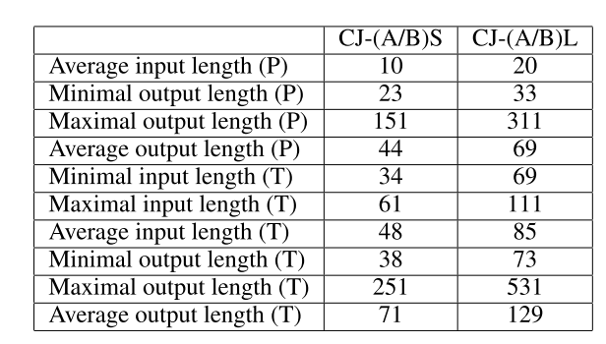
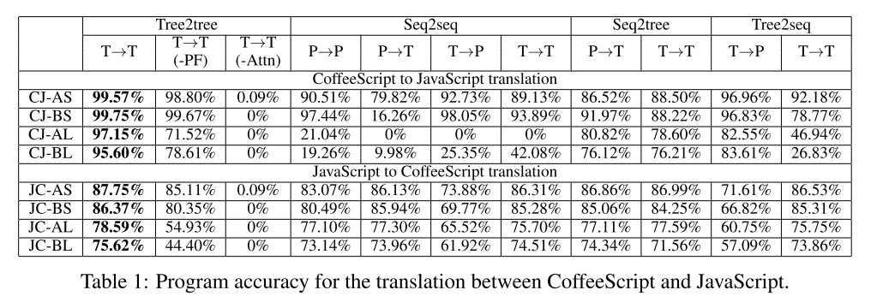
Evaluation
Results on the CoffeeScript-JavaScript Task
XY-ZW:
X and Y (C or J) indicate the source and target languages respectively;
Z (A or B) indicates the vocabulary: vocabulary A uses {x,y} as variable names and {0,1} as literals; vocabulary B uses all alphabetical characters as variable names, and all single digits as literals.
W (S or L) indicates the program length: S means that the CoffeeScript programs has 10 tokens on average; and L for 20.
Notes:
tree2tree model outperforms all baseline models on all datasets. Especially, on the dataset with longer programs, the program accuracy significantly outperforms all seq2seq models, Especially, on the dataset with longer programs
PF 在Large program中更加重要
JavaScript to CoffeeScript：提升较小，原因是target programs are much shorter. a CoffeeScript program with 20 tokens, its corresponding JavaScript program may contain more than 300 tokens.

Slide 18
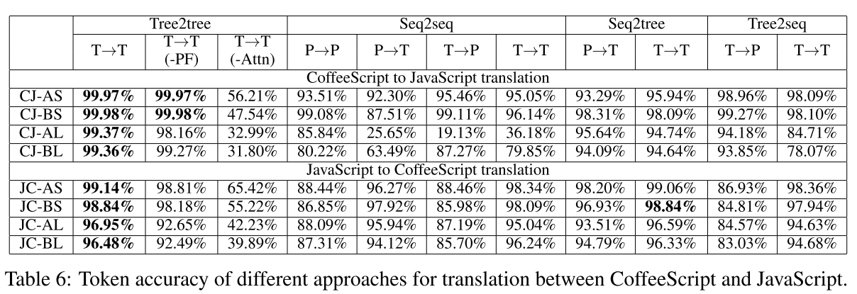
Evaluation
Results on the CoffeeScript-JavaScript Task

Slide 19
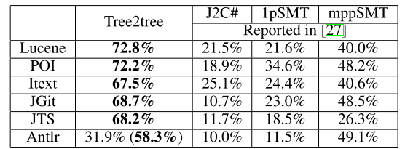
Evaluation
Results on Real-world Projects
Baselines: three state-of-the-art program translation approaches
J2C#: a rule-based system
1pSMT: multi-phase phrase-based SMT approach that leverages both the raw programs and their parse trees.
mppSMT: phrase-based SMT on sequential programs
Notes:
Antlr contains too few data samples for training. We constructing another training and validation set from all other 5 projects, and test our model on the entire Antlr.

Slide 20
Conclusion

Slide 21
Conclusion
Challenges in program translation
Models are hard to generalize to programs longer than the training ones.
It is unclear how to handle an infinite vocabulary set that may be employed in real-world applications.
The training requires a dataset of aligned input-output pairs, which may be lacking in practice.

Slide 22
Thanks
Tree-to-tree Neural Networks for Program Translation

